Slide 1


Deep Learning Theory and Applications RNNs and LSTMs
CPSC/AMTH 452/552
CBB 663

Slide 2
Question
Do CNNs work on data with time structure rather than space structure?
What if the time-structure has variable lengths?

Slide 3
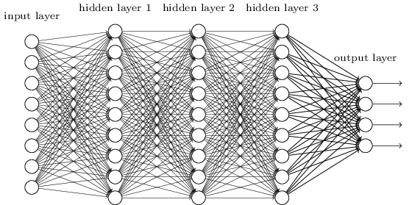
Fixed sized inputs
Normal neural networks have to have predetermined input size

Slide 4
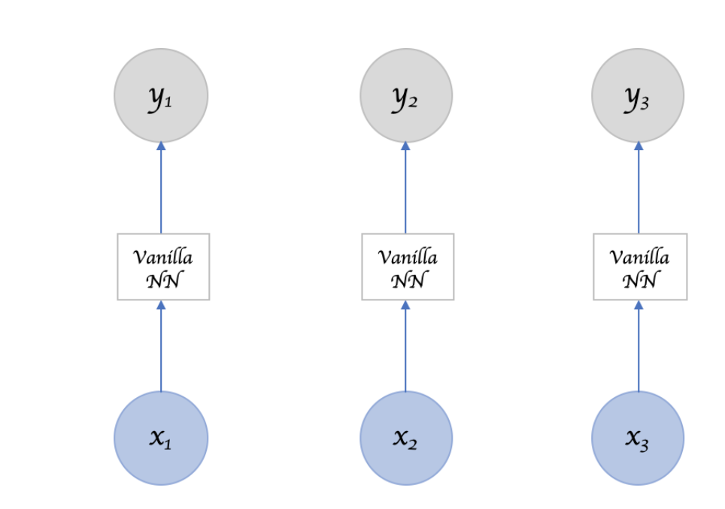
Contrast with calling NN repeatedly
Order and sequence matters

Slide 5
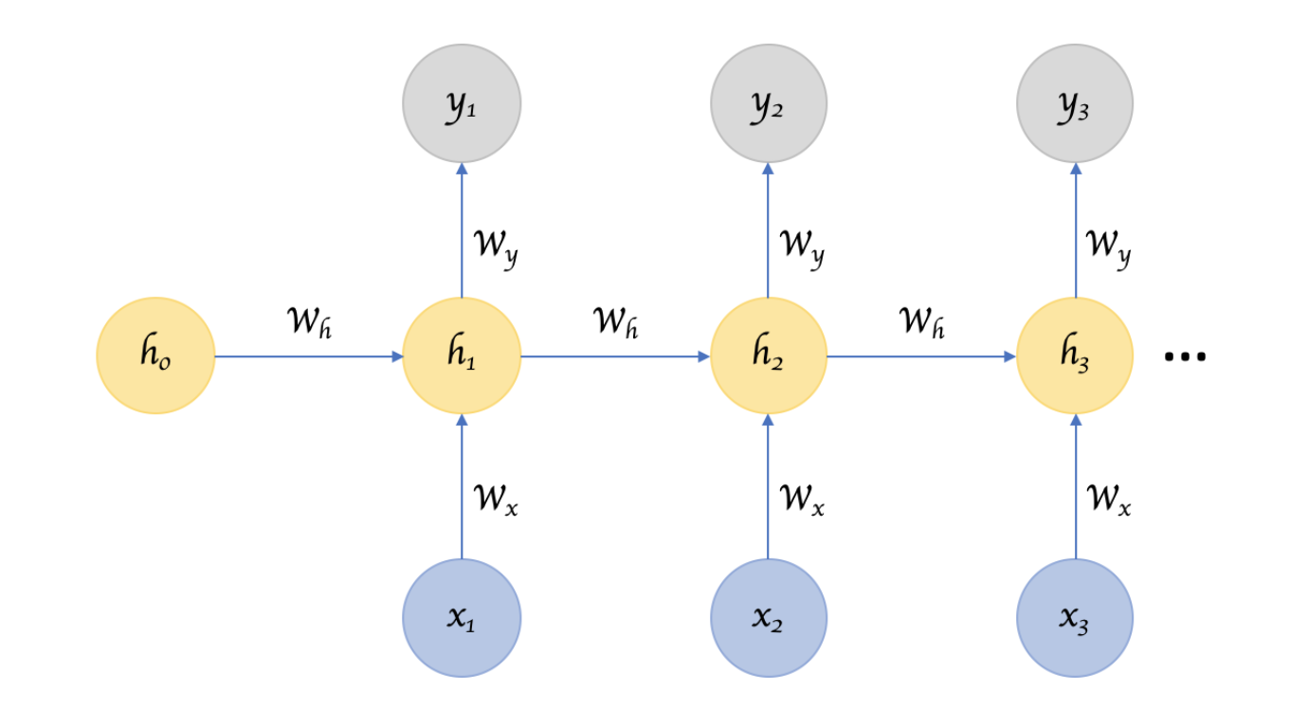
Recurrent Neural Networks
Takes arbitrarily sized inputs and
“remember” a hidden state of
information

Slide 6
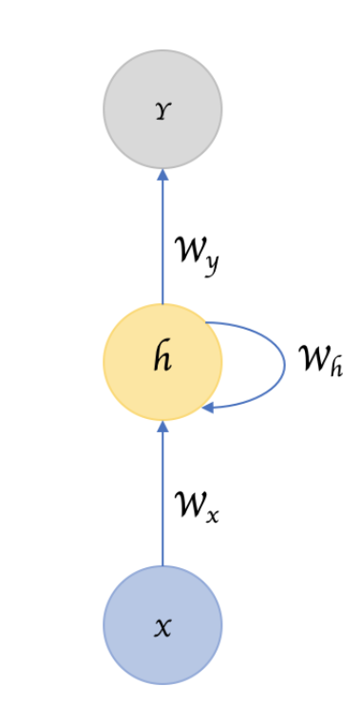
Feed forward vs Self-Loops

Slide 7
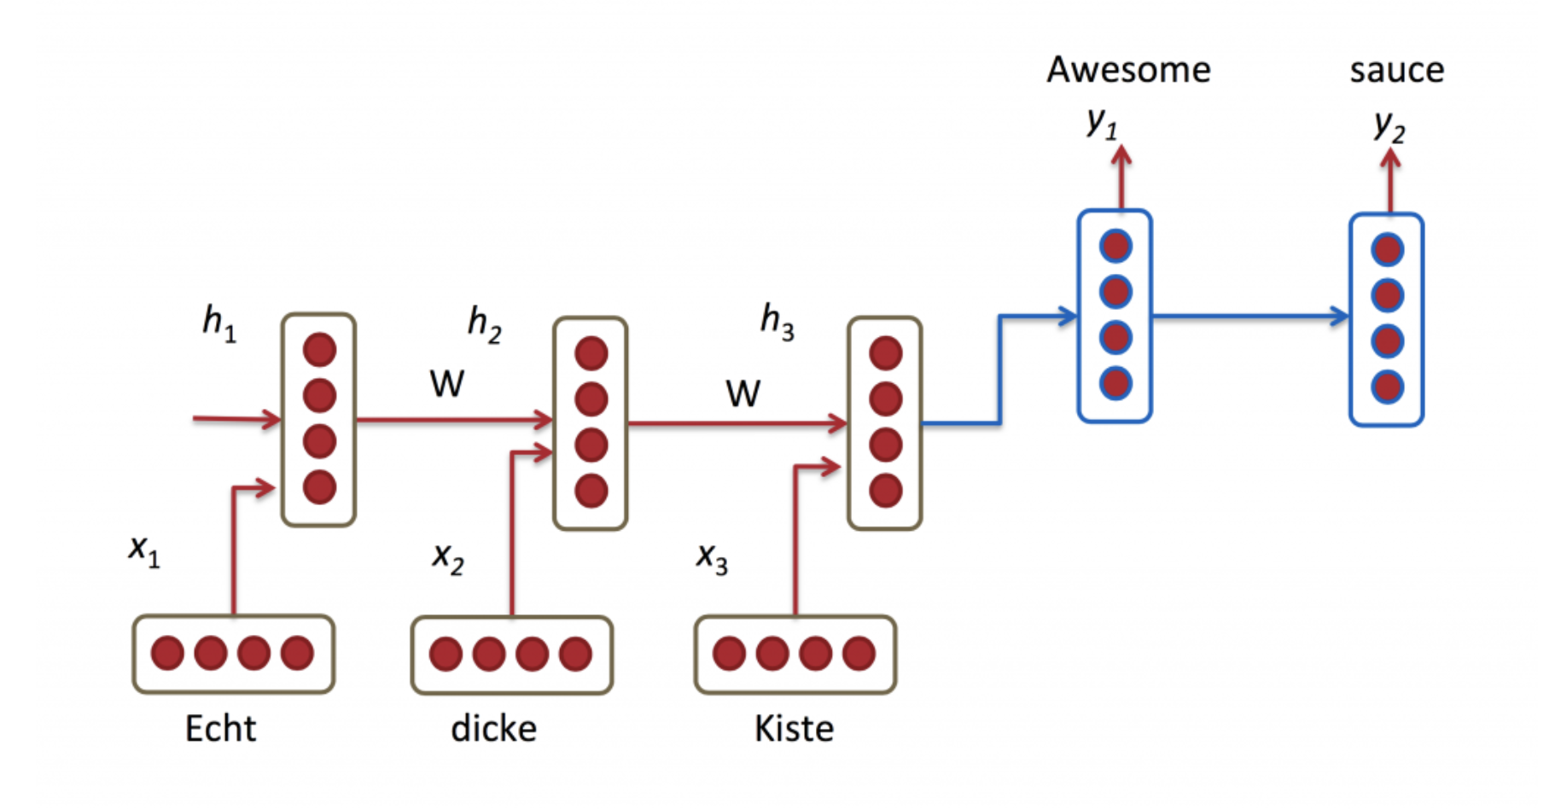
Processing Sequential Input

Slide 8
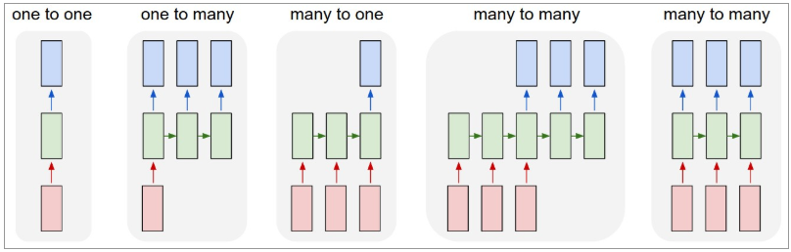
Sequence oriented tasks
Variable length inputs, variable length outputs, variable length computation

Slide 9
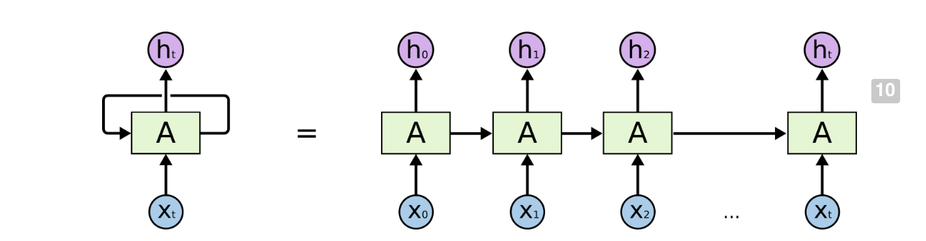
Backpropagation Through Time (BPTT)

Slide 10
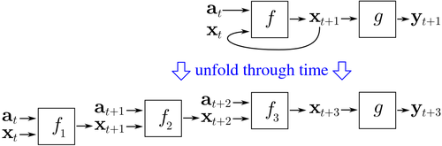
All unfoldings share parameters

Slide 11
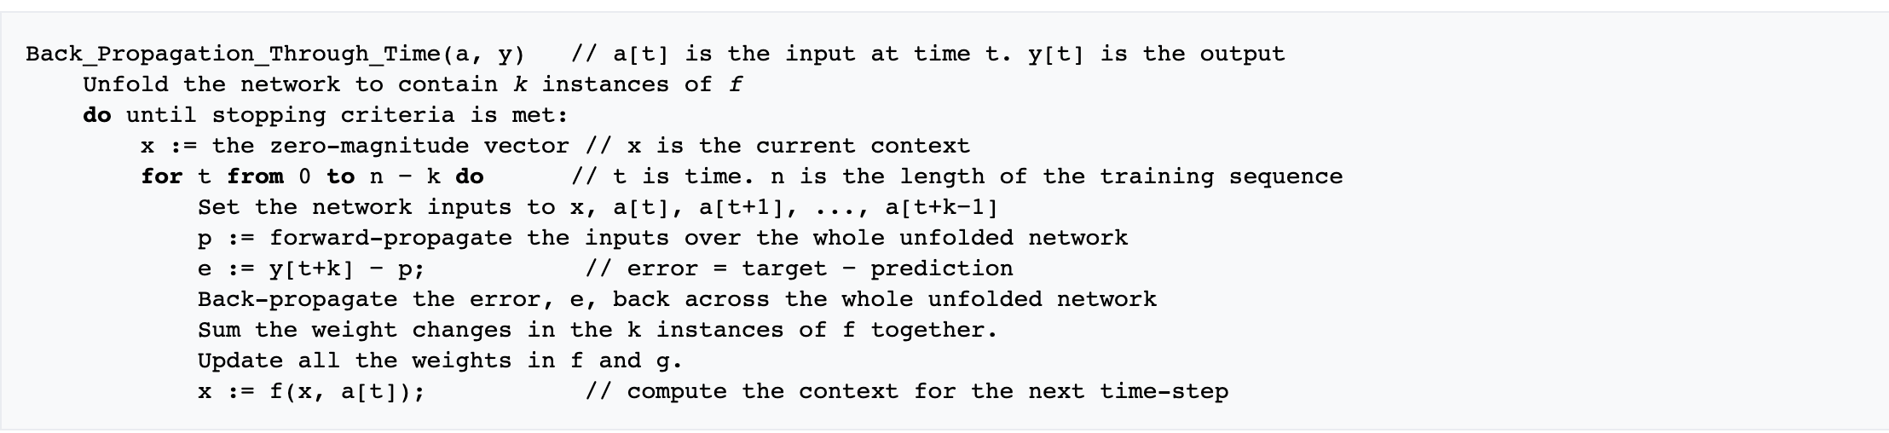
BPTT Computes Gradients for Many Time Steps

Slide 12
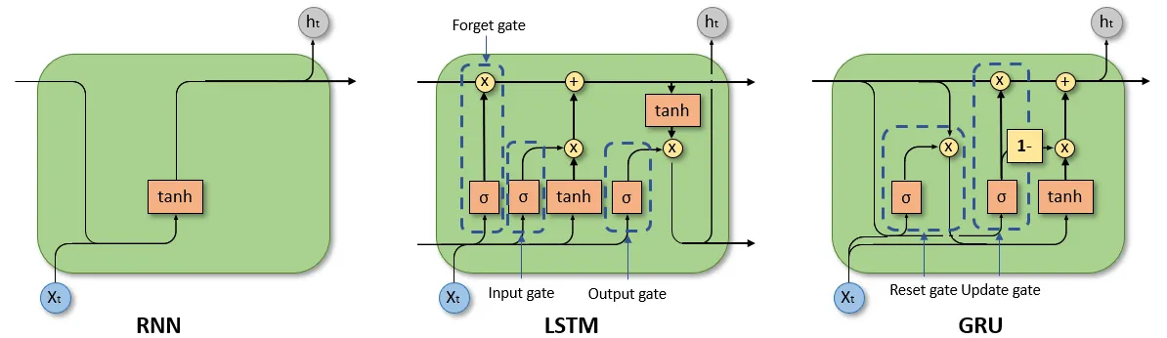
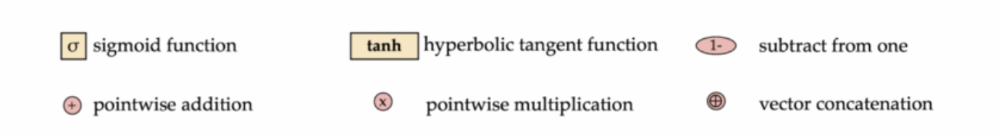
Comparison of unit of RNN, LSTM, GRU

Slide 13

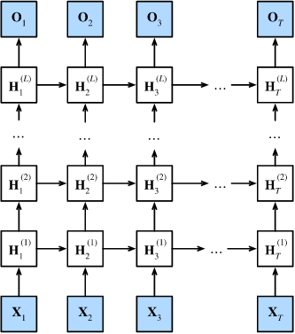
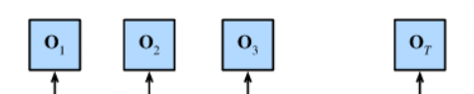
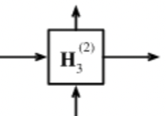
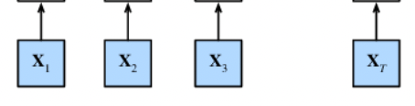
undirectional RNN with one hidden layer
final output depends on task
output sequence of length T
Output layer
Layer 1
H₀⁽¹⁾ →
an RNN unit
Embedding layer
Input layer
token 1
token 2
token 3
token T
input sequence of length T

Slide 14
stacked undirectional RNN
final output depends on task
output sequence of length T
Output layer
Layer L
H₀^{(L)} →
an RNN unit
L hidden layers
Layer 2
H₀⁽²⁾ →
Layer 1
H₀⁽¹⁾ →
Embedding layer
Input layer
token 1
token 2
token 3
token T
input sequence of length T

Slide 15
Language modelling (character-level)
output sequence of length 5: h,e,l,l,o,[EOS]
Softmax layer
h
e
l
[EOS]
Output layer
Layer L
H₀^{(L)} →
an RNN unit
L hidden layers
Layer 2
H₀⁽²⁾ →
Layer 1
H₀⁽¹⁾ →
Embedding layer
Input layer
[BOS]
h
e
o
input sequence of length 5 [BOS], h,e,l,l,o

Slide 16
Language modelling (word-level)
output sequence of length 5 old, are, you,now, [EOS]
Softmax layer
old
are
you
[EOS]
Output layer
Layer L
H₀^{(L)} →
an RNN unit
L hidden layers
Layer 2
H₀⁽²⁾ →
Layer 1
H₀⁽¹⁾ →
Embedding layer
Input layer
[BOS]
How
old
you
input sequence of length 5 [BOS], How, old, are, you

Slide 17
Sequence labelling (POS tagging)
Output sequence of length 6 (NNP, VBZ, DT, JJ, NN, [EOS])
Softmax layer
NNP
VBZ
DT
[EOS]
Output layer
Layer L
H₀^{(L)} →
an RNN unit
L hidden layers
Layer 2
H₀⁽²⁾ →
Layer 1
H₀⁽¹⁾ →
Embedding layer
Input layer
[BOS]
Mary
has
sheep
input sequence of length 6 ([BOS], Mary, has, a, little, sheep)

Slide 18
Text Classification (sentiment analysis)
Positive
Feedforward network
MLP+sigmoid
Output layer
Layer L
H₀^{(L)} →
an RNN unit
RNN
Layer 2
H₀⁽²⁾ →
Layer 1
H₀⁽¹⁾ →
Embedding layer
Input layer
[BOS]
The
movie
good
input sequence of length 4 [BOS], The, movie, is, good

Slide 19
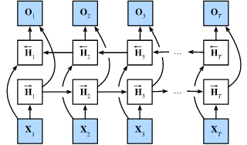
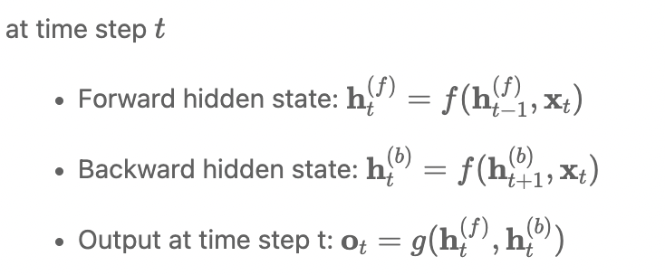
Bidirectional RNN with one layer
output sequence of length T
output layer
backward hidden layer
forward hidden layer
embedding layer
Input layer
token 1
token 2
token 3
token T
input sequence of length T

Slide 20
Sequence labelling (POS tagging)
Output sequence of length 6 (NNP, VBZ, DT, JJ, NN, [EOS])
Softmax layer
NNP
VBZ
DT
[EOS]
output layer
backward hidden layer
BiRNN
forward hidden layer
embedding layer
input layer
[BOS]
Mary
has
sheep
input sequence of length 6 ([BOS], Mary, has, a, little, sheep)

Slide 21


character-level word embedding
word embedding
concatenation
$$⨁$$
backward hidden layer
BiRNN
forward hidden layer
embedding layer
input layer
h
e
l
o
input sequence of length 5 (h, e, l, l, o)

Slide 22
classification (sentiment analysis)
Positive
Feedforward network
MLP+sigmoid
concatenation
$$⨁$$
backward hidden layer
BiRNN
forward hidden layer
embedding layer
input layer
[BOS]
The
movie
good
input sequence of length 5 ([BOS], The, movie, is, good)

Slide 23
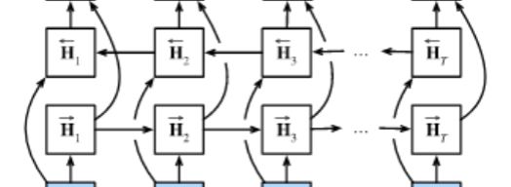
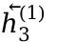
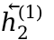
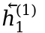
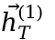
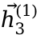

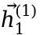

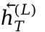
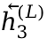
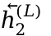
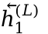
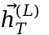
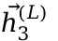

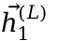
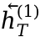
stacked Bidirectional RNN
output sequence of length T
output layer
$${\overset{⃖}{h}}_{1}^{(L)}$$
$${\overset{⃖}{h}}_{2}^{(L)}$$
$${\overset{⃖}{h}}_{3}^{(L)}$$
$${\overset{⃖}{h}}_{T}^{(L)}$$
backward
hidden layer L
$${\vec{h}}_{1}^{(L)}$$
$${\vec{h}}_{2}^{(L)}$$
$${\vec{h}}_{3}^{(L)}$$
$${\vec{h}}_{T}^{(L)}$$
forward
... ... ... ...
L hidden layers
$$⨁$$
$$⨁$$
$$⨁$$
$$⨁$$
$$⨁$$
concatenation of forward hidden state vector and backward hidden state vector from each layer
$${\overset{⃖}{h}}_{1}^{(1)}$$
$${\overset{⃖}{h}}_{2}^{(1)}$$
$${\overset{⃖}{h}}_{3}^{(1)}$$
$${\overset{⃖}{h}}_{T}^{(1)}$$
backward
hidden layer 1
$${\vec{h}}_{1}^{(1)}$$
$${\vec{h}}_{2}^{(1)}$$
$${\vec{h}}_{3}^{(1)}$$
$${\vec{h}}_{T}^{(1)}$$
forward
input layer
input sequence of length T

Slide 24
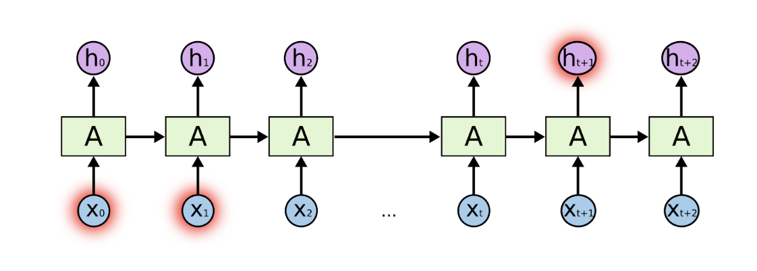
RNNs not good at handling long term dependencies

Slide 25
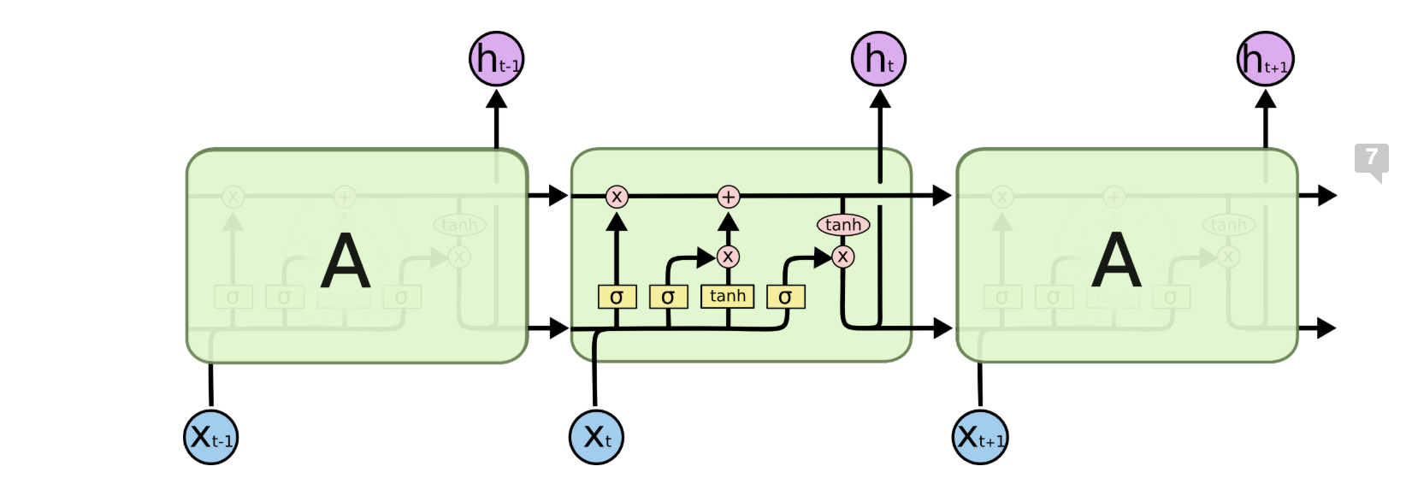
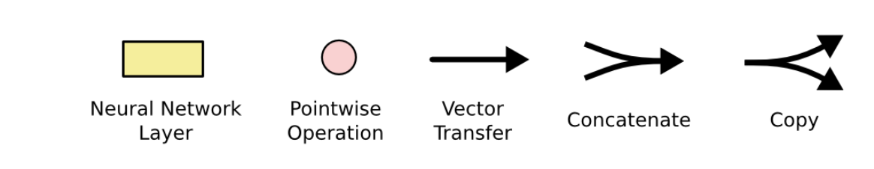
Notation

Slide 26
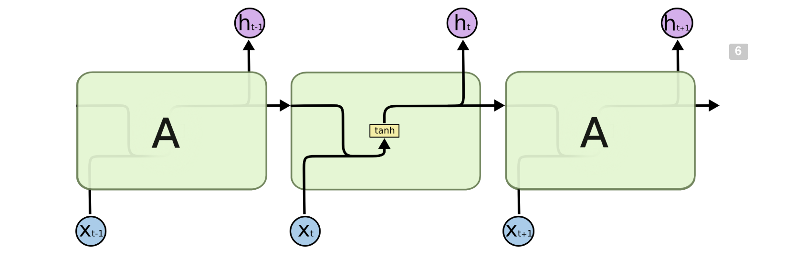
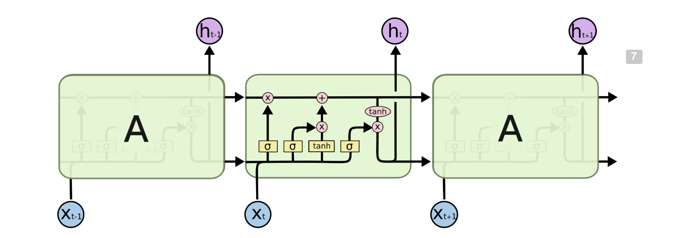
LSTMs

Slide 27
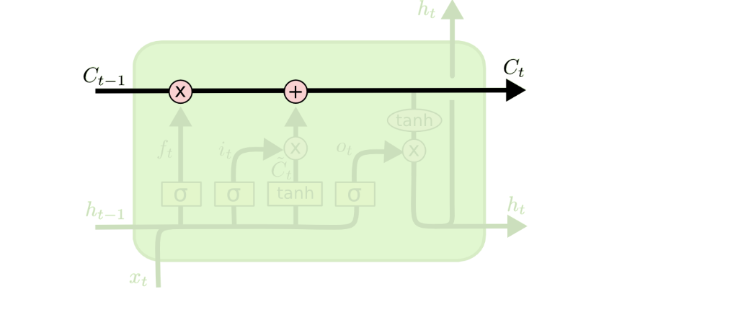
Running Cell State

Slide 28
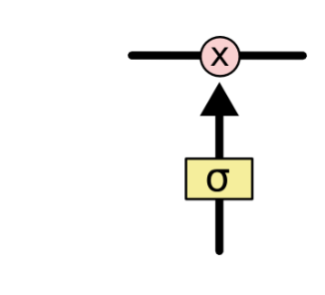

Gates modify hidden state
A gate is implemented as a sigmoidal layer that outputs a value between 0 and 1 and controls how much of an input should be let through
0=don’t let anything through
1= let everything through
Indicates pointwise multiplication

Slide 29
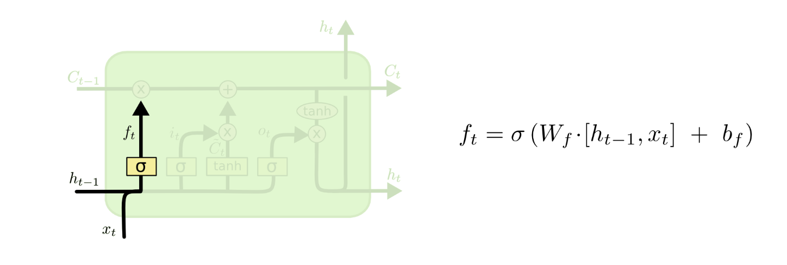
Forget Gate
How much of the previous hidden state should be forgotten?

Slide 30
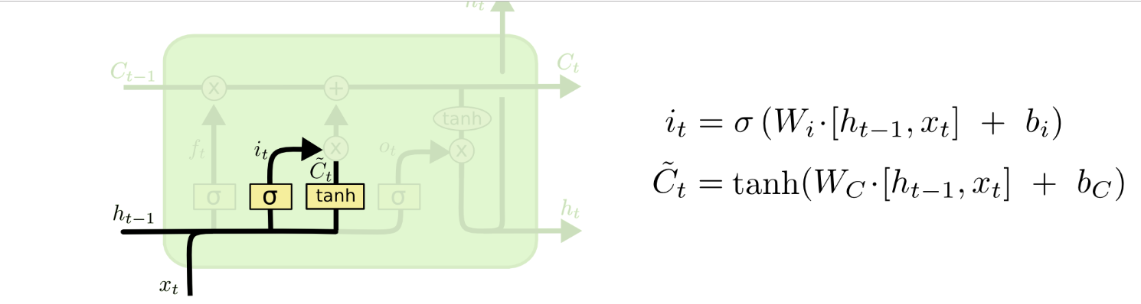
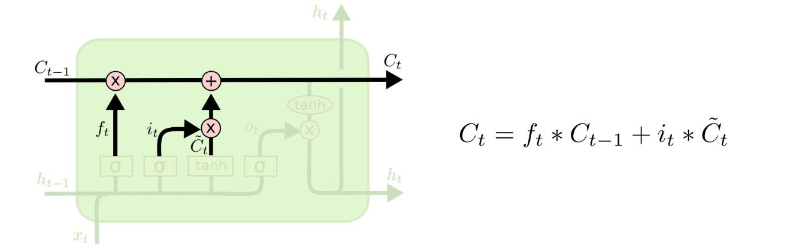
Creating New Hidden State

Slide 31
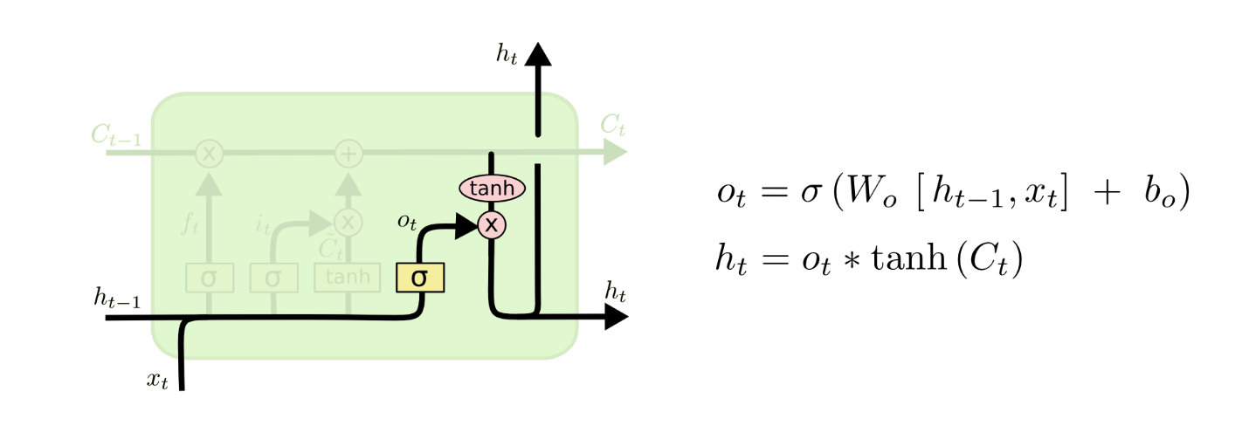
Output

Slide 32
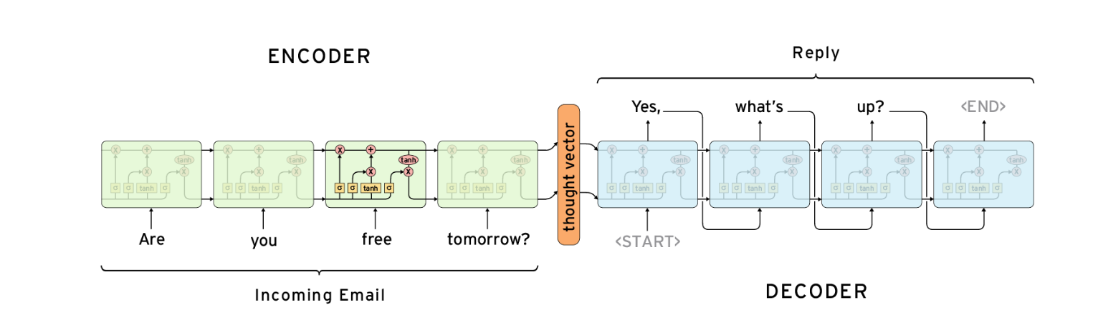
seq2seq model: LSTM encoder-decoder
Email autoreply
German sentence
Ich ging nach [EOS]
Machine translation
I want go home
English sentence
reconstructued sentence
I want go home
language modeling
I want go home
original sentence

Slide 33
Natural Language Processing
Field of AI concerned with interactions between humans and computers
How to program computers to process and analyze natural language data (as opposed to computer languages)

Slide 34
NLP Tasks
Speech recognition
Natural language generation
Natural language understanding
More specific tasks
Machine translation
Sentiment Analysis
Question Answering
Text generation

Slide 35
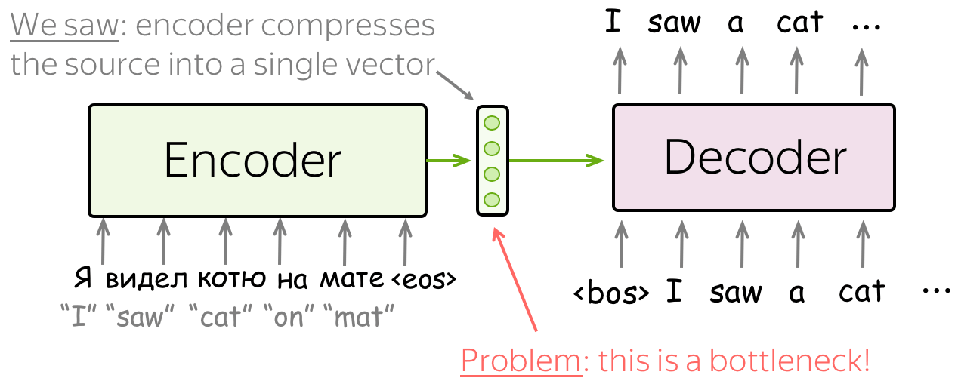
Problem

Slide 36
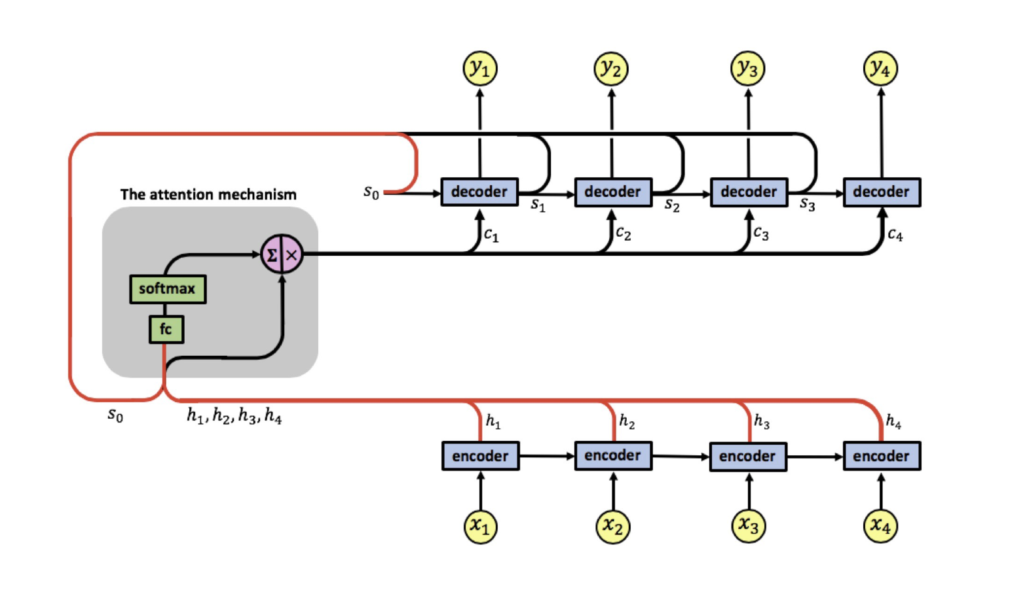
Adaptively Allows Decoder to Choose Inputs

Slide 37
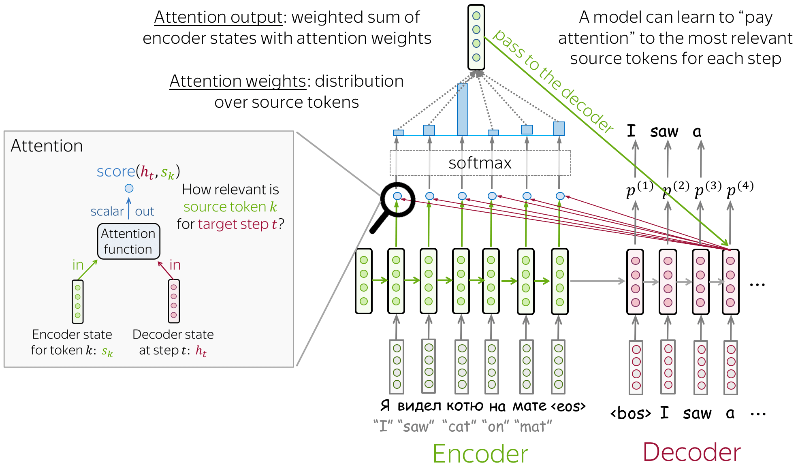
Attention Mechanism

Slide 38
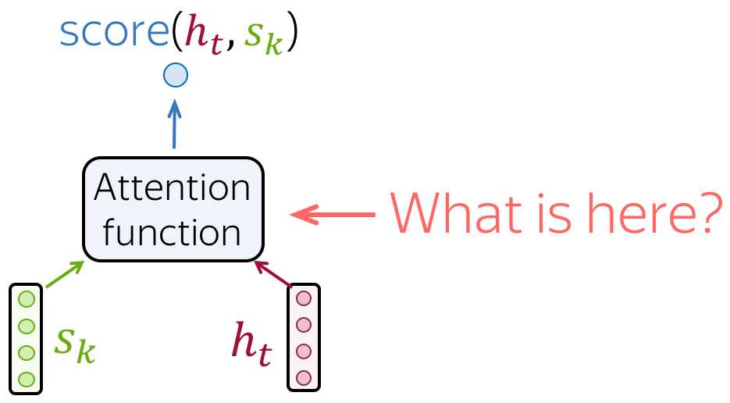
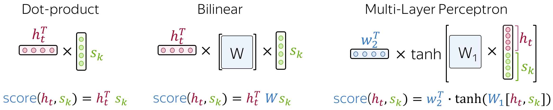
Attention Score

Slide 39
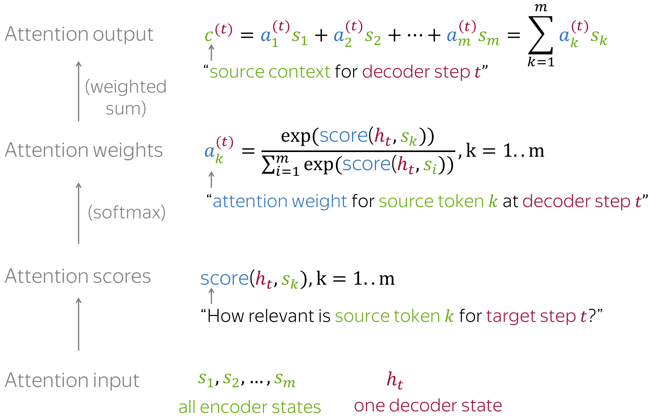
Attention Computations

Slide 40

Interpreting Attention

Slide 41



Machine Translation
Statistical machine translation:
P(e|f) e = english phrase f= foreign phrase
Translates n-grams phrases consisting of n-words

Slide 42


Neural Machine translation
Encoder-decoder architecture
Cho et al 2014, Sutskever 2014

Slide 43

Bidirectional RNN

Slide 44


Sentiment Analysis
I do not dislike cabin cruisers. (negation handling)
Polarity:

Slide 45

Beyond Polarity

Slide 46


Slide 47

Word vector Embedding

Slide 48

Word vectors

Slide 49

Output calculation
Training on negative samples improves this.

Slide 50

Character Level Language Model

Slide 51

Hierarchical Model

Slide 52

Text Generation
Text generation databases: Paul Graham Essays, Project Gutenberg

Slide 53

RNN for Text Generation
2-layer LSTM

Slide 54

Depth helps!
3-layer LSTM

Slide 55

Baby Names
New names that have not been sampled before!

Slide 56

Evolution of a language model: Iteration 100
What did the network learn so far?
Words and spaces.

Slide 57

300 Iterations
Punctuation

Slide 58

Iteration 500
Spelling short words

Slide 59

Iteration 700
Word ordering

Slide 60

Image Captioning

Slide 61
Reading list
Chapter 10 Goodfellow
Miklov et al. Efficient Estimation of Word Representations in Vector Space ,2013
Luong et al. Effective Approaches to Attention-based Neural Machine Translation 2015
https://arxiv.org/pdf/1409.0473.pdf
Hochreiter & Schmidhuber Long Sort Term Memory, 1997
https://medium.com/datadriveninvestor/attention-in-rnns-321fbcd64f05
http://colah.github.io/posts/2015-08-Understanding-LSTMs/
https://lena-voita.github.io/nlp_course/seq2seq_and_attention.html

